Slide 1


Applications of E-learning Portals R.SURYA(192011244) BE(CSE),3rd year

Slide 2
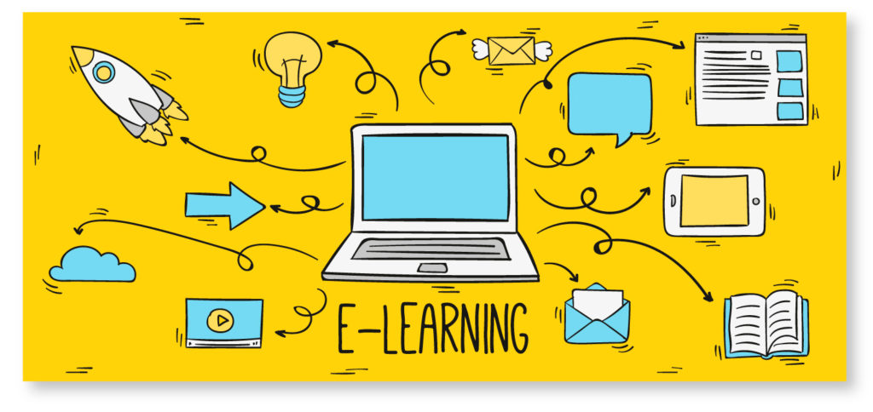
Aim:To analysis the applications and test cases for e-learning portal.

Slide 3
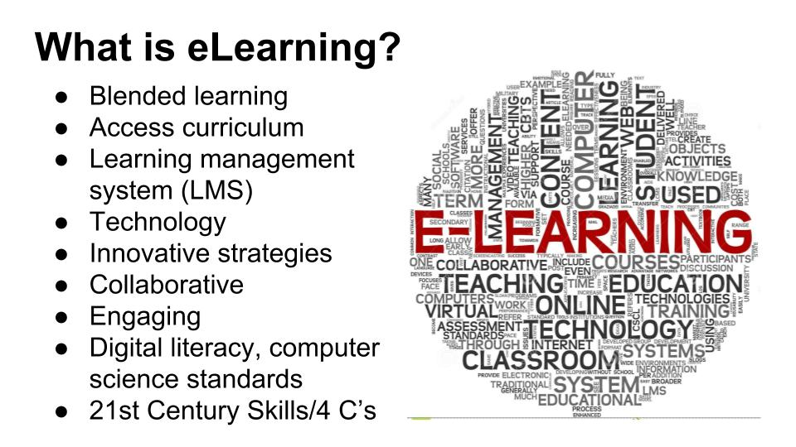

Slide 4
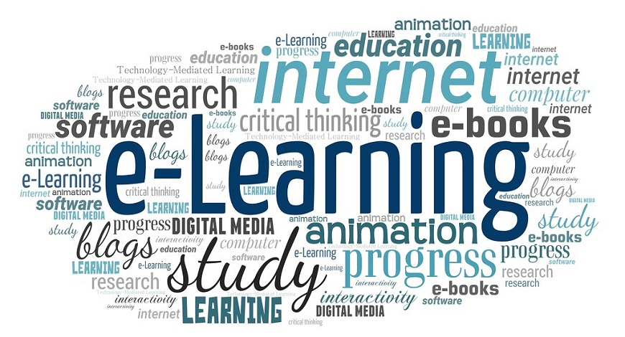
What is E-learning?
A learning system based on formalized teaching but with the help of electronic resources is known as E-learning. While teaching can be based in or out of the classrooms, the use of computers and the Internet forms the major component of E-learning.

Slide 5
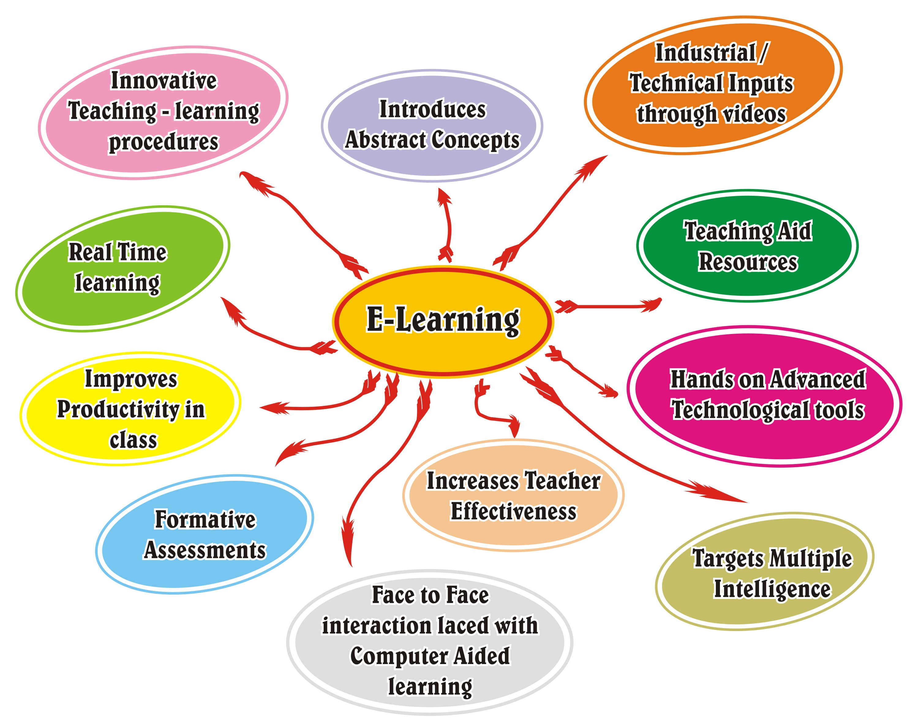

Slide 6

The Most Important Benefits Of e-Learning For Students.
Today's learners want relevant, mobile, self-paced, and personalized content. This need is fulfilled with the online mode of learning; here, students can learn at their own comfort and requirement. Let's have an analytical look at the advantages of online learning.

Slide 7
1. Online Learning Accommodates Everyone’s Needs
The online method of learning is best suited for everyone. This digital revolution has led to remarkable changes in how the content is accessed, consumed, discussed, and shared. Online educational courses can be taken up by office goers and housewives too, at the time that suits them. Depending on their availability and comfort, many people choose to learn at weekends or evenings.

Slide 8
2. Lectures Can Be Taken Any Number Of Times
Unlike classroom teaching, with online learning you can access the content an unlimited number of times. This is especially required at the time of revision when preparing for an exam. In traditional form of learning, if you can not attend the lecture, then you have to prepare for that topic on your own; in eLearning, you can attend the lectures whenever you want with ease.

Slide 9
3. Offers Access To Updated Content
A prime benefit of learning online is that it makes sure that you are in synchronization with modern learners. This enables the learner to access updated content whenever they want it.

Slide 10
4. Quick Delivery Of Lessons
eLearning is a way to provide quick delivery of lessons. As compared to traditional classroom teaching method, this mode has relatively quick delivery cycles. This indicates that the time required to learn is reduced to 25%-60% of what is required in traditional learning. There are some of the reasons why the learning time is reduced by eLearning:
Lessons starts quickly and also wrapped up in a single learning session. This enables training programs to easily roll out within a few weeks, or sometime even days.
Learners can define their own speed of learning instead of following the speed of the whole group.
Saves time as a student does not need to travel to the training venue. You can learn at the comfort of your own place.
Students can choose to study specific and relevant areas of the learning material without focusing on each and every area. For example, they can skip certain areas they do not want to learn.

Slide 11
5.Scalability and Consistency
eLearning helps in creating and communicating new training, policies, concepts, and ideas. Whether it is for formal education or entertainment, eLearning is very quick way of learning.
eLearning enables educators to get a higher degree of coverage to communicate the message in a consistent way for their target audience. This ensures that all learners receive the same type of training with this learning mode.

Slide 12
6. Reduced Costs
eLearning is cost effective as compared to traditional forms of learning. The reason for this price reduction is because learning through this mode happens quickly and easily. A lot of training time is reduced with respect to trainers, travel, course materials, and accommodation.
This cost effectiveness also helps in enhancing the profitability of an organization. Also, when you are studying at your own place, you are relieved from paying for travel expenses (e.g. accommodation) when training happens in another city/state and/or external learning materials.

Slide 13
Test cases Scenario(Positive):
Checks the valided Username ID and Password are filled the blanks and verify it
Checks the valided Email-address and the phone number for country verifications
Makes the username as a common and Password should be strong characters name and numerical.
Can reconfirming the given e-mail address and also password after the registration in portals
Can be logged in portals after getting One-Time Password(OTP) for four-digit number and Re-capache(Verify as Human) with puzzles and code numbers.

Slide 14
Test Cases Scenario(Negative):
If the user-id and password are blank, it show error and messaging as “Enter the UserID and Password”.
If the user-id is invalid and password is correct, then it show error and messaging as “The UserID is invalid”.
Username is correct , but password is incorrect means it will messaging as “The password is invalid”.
It can be cancelling the User-ID by the portals administative , then it shows “Your ID name was Cancelled . Please Contact the Administative” as a Blank Data.
If you don’t know the password, there is an option “Forget the password?”.It will ask to reset the password in same username and email- address.

Slide 15
Test Cases for Functional
Verify if a user will be able to login with a valid username and valid password-Positive
Verify if a user cannot login with a valid username and invalid password-Negative
Verify the ‘Forget Password’ functionality-Positive
Verify the login page for both, when the field is blank and Submit button is clicked-Negative
Verify the messages for invalid login-Positive
Verify the “Remember Me” functionality-Positive
Verify if the “Enter” key of the keyboard is working correctly on the login page-Positive

Slide 16
Test Cases In Non-Functional
Verify if a user cannot enter the characters more than the specified range in each field (Username and Password)-Negative
Verify if a user cannot enter the characters more than the specified range in each field (Username and Password).-Positive
Verify the timeout functionality of the login session.-Positive.
Verify the login page by pressing ‘Back button’ of the browser. It should not allow you to enter into the system once you log out.-Negative
Verify if a user should be able to login with the same credentials in different browsers at the same time.-Positive

Slide 17
Thank You

